Slide 1
Slide 1

Slide 2
Data Models
Hierarchical
Network
Relational

Slide 3
Hierarchical
root
Binary Tree
Traverse is faster
But if the middle nodes are deleted reaching the leaf nodes from the root is not possible
leaf
leaf
leaf
leaf

Slide 4
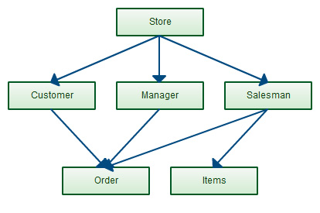
Network
Mesh Topology
Data is accessible even if a node in between is deleted
But creating this topology is very difficult.

Slide 5
Relational Model
Matrix
Tuples – Records, Attributes – Fields, Domain – Value / Data
Supports all types of relationship between tables
1-1, 1- Many, Many – Many
Satisfies almost all the Codes Rules ( 12 )
DBMS: 1 to 6 rules
MAXIMUM RDBMS: those comply with 6 to 12 rules
SQLServer, Oracle, DB2, MYSQL
Visual Foxpro complies with all the 12 rules

Slide 6

PostgreSQL (Postgres) Versions
95
6.0
11
12
13
14
https://www.postgresql.org/support/versioning/
https://www.postgresql.org/docs/release/
Document:
https://www.postgresql.org/docs/

Slide 7
Standards
SQL : ANSI – Standard Query Language | To talk to the Database

Slide 8
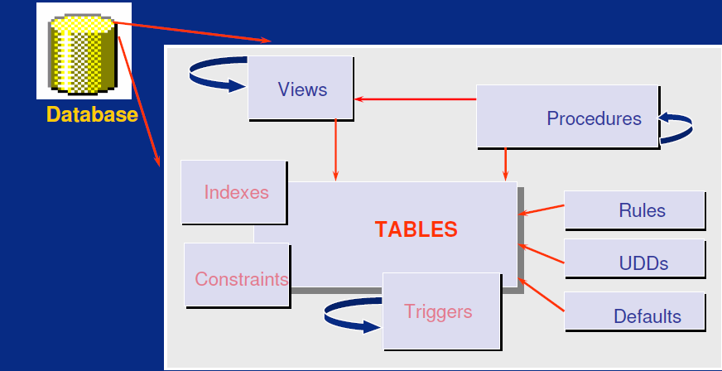

Slide 9
Database Objects
Tables, Views, Stored Procedure, Rules, UDDs, Defaults,
Triggers, Indexes, Constraints
---------------------------------------------------------------------
When a Table is deleted which are the Objects that will get deleted?
Triggers, Indexes, Constraints – attached to Table
---------------------------------------------------------------------
Invalid Objects : Views, Stored Procedure,
Resurrection : becomes Valid as soon as a new table with the same name is created

Slide 10
Normalization

Slide 11
Courseid
Coursename
Description | Studid
Fees | name
Duration | present
Timings
Studid
Name | Sem1
qualification | Sem2
experience | Sem3
interest | Sem4
DOB
contactno
emailid
address
courseid | Total
coursename | Avg
fees | Grade
timings
Unnormalized Form

Slide 12
Unnormalized Form
Student Details
Studid
Name
qualification
experience
interest
DOB
contactno
emailid
address
courseid
coursename
fees
timings
Course Details
Courseid
Coursename
Description
Fees
Duration
Timings
Attendence
Studid
name
Present / absent
Marks | Aggregate
Sem1 | Total
Sem2 | Avg
Sem3 | Grade
Sem4

Slide 13
First norm Form
Course Details
Courseid
Coursename
Description
Fees
Duration
Timings
Student Details
Studid
Name
qualification
experience
interest
DOB
contactno
emailid
address
courseid
Marks
Sem1
Sem2
Sem3
Sem4
Marks Aggregate
Total
Avg
Grade
Attendence
Studid
Present / absent

Slide 14
Second norm Form
Marks
Course Details
Courseid
Coursename
Description
Fees
Duration
Timings
Student Details
Studid
Name
qualification
experience
interest
DOB
contactno
emailid
address
courseid
Studid
Sem1
Sem2
Sem3
Sem4
Marks Aggregate
Attendence
Studid
Present / absent
Studid
Total
Avg
Grade

Slide 15
Normalized data
Courseid
Coursename
Description
Fees
Duration
Timings
Studid
Sem1
Sem2
Sem3
Sem4
Total
Avg
Grade
FK
Studid
Name
qualification
experience
Studid
Present / absent
FK
interest
FK
DOB
Courseid
Studid
joindate
completeddate
status
contactno
FK
emailid
address

Slide 16
Normalization
From Un normalized data to Normalized data
First Norm form: Avoid redundancy
Second Norm form: Functional dependency. Establish the relationship between datasets. Requires domain expertise. To be done by Business Analyst.
Foreign key ( a local representation of a remote primary key)
Third Norm : Transient dependency . ( inter linked data) If there are related data in 2 or more tables, then move them to one table. Updating them will be efficient.
De normalization : Only for OLAP – selecting from one table is faster than retrieving from multiple tables through joins.
De-normalization can be done only from a Normalized data and not from Un Normalized Data

Slide 17
Best Practices
Columns per table – (1024) – for a normalized table don’t create more than 10 cols
No of tables that can be joined in a select – (256) – don’t join more than 4 tables
Columns in a select statement (4096)- 4x10 = 40
32767 data bases per SQL Server Instance
32767 files per data base
Parameters per SP (2100) :
Indexes per table – (250 ) – (1 Clustered, 249 NC)

Slide 18
Under pressure
you don’t rise to the occasion,
You sink to the level of your Training.
That’s why we train hard.
Seek being uncomfortable …..
That is where you will find greatness

